Slide 1
Congratulations to our wonderful second graders for a fabulous year!!
It’s time to think about the summer and what’s coming next for your child.

Slide 2
This year our second graders have learned a lot!!
Throughout your child’s primary years, grades K – 2, students have worked on learning how to read.
This involved learning power words that are seen in many texts, learning how to add endings to words, to learn how to chunk and apply the phonics rules that we taught.
Our main focus was LEARNING TO READ

Slide 3
Now it’s off to Intermediate grades!!
You’ll see some big changes next year. The biggest one is how reading instruction is given. The big shift is from LEARNING TO READ to READING TO LEARN.
This means that your child will be more responsible to taking what they read from text and applying this information in how they express themselves in writing or how they analyze text.

Slide 4
We’ve been preparing your child for this since the beginning!
Even when your child was still learning letter sounds, the teachers have been working on asking students questions about what they are reading. There have been basic questions, like asking what the story was mainly about, to very in-depth questions, like “How does this picture enhance your understanding of the character/setting/main problem?”
Our reading goals have always been for your child to really understand what they are reading and to ask questions while they read.

Slide 5
Unfortunately, every summer, students experience what we call the “summer slide.”
Parents get busy, kids get busy, everyone is off the schedule of school and everyone needs a break.
This sometimes has some consequences that are hard to make up.

Slide 6
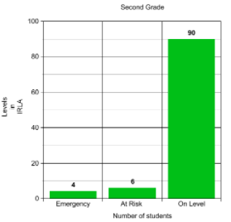
Last year at DOES:
This is how we ended the school year:

Slide 7
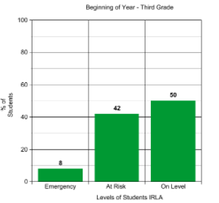
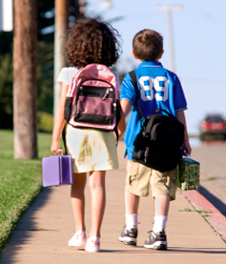
When they came back and started third grade, the teachers screen all students’ IRLA levels again.
This is how the last year’s third graders looked at the beginning of the school year.

Slide 8
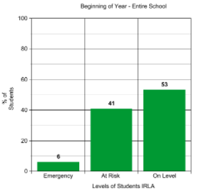
It doesn’t just happen in this grade level. Let’s look at the entire school data:

Slide 9
As a team, parents and teachers working together, it’s our goal to make this pattern change!
There are some simple strategies to have fun this summer AND not have the ”summer slide”.
The key is making reading fun!!

Slide 10
Here are some ideas:
Make a tent in the house and give them a flashlight and pillows.
Make regular trips to the library *DOES will be open 5 nights this summer; join us!
Have a coffee/tea break. You read the paper or your e-mails, your child gets to read.
Wrap up books (even ones you currently have) and have your child unwrap this “gift”.
Snuggle together on the coach or bed. Take turns reading.
And most importantly – TALK to your child about what they are reading. They are now READING to LEARN.

Slide 11
When you read with your child use questions like:
Fiction:
What is the story about?
Who is the main character? What is he/she like?
What problem did he/she encounter? How was the problem solved?
If you were that character what would you do?
What was your favorite part?
What do you think will happen next? Why do you think that will happen?
Were there any unfamiliar words that you need help with?
Non-Fiction:
What is the book about?
What did you find most interesting?
What facts did you learn?
What questions do you still have about this topic?
Where do you think we could find those answers?
Would you like to research this topic further on the internet?
Were there any unfamiliar words that you need help with?

Slide 12
Remember, the key is fun!!
If your child comes to a word he or she doesn’t know, have them skip it and go back to it. See if the word can be figured out making connections with the surrounding words. If not, just tell them the word. Your child should read books that contain no more than 5 unknown words per page to make it a fluent text.
Have fun!! Take turns with voices, rent or get the audio tapes from the library to listen to books, find articles in the newspaper or magazines to talk about, make scrapbooks with vacation memories… just READ together!

Slide 13
Next year the focus will also be on building grade level vocabulary.
This is the easiest thing to do as a parent. It involves just having conversations with your child. Kick the vocabulary up a notch and begin talking with them on a higher level. The more a child is exposed to conversations with other people, the higher their written and spoken vocabulary is. Use those long car rides for having some great conversations!

Slide 14
There are many incentives around the community and here at DOES to encourage reading:
AR for incoming 3rd graders will start over the summer!! Keep an eye out on the DOES website for more information.
Public library has a summer reading program they are launching in the beginning of June. Visit the library for a flyer with all the incentives
Barnes and Nobles has a program that students can read 8 books and keep a journal that asks them to do a quick summary of what they read. When they turn it in, they get a FREE book!! Visit the Barnes and Nobles website for more information.

Slide 15
Let’s not forget about math!
Your child focused this year on being able to add and subtract two and three digit numbers with and without regrouping, and to be able to fluently add and subtract to 20.

Slide 16
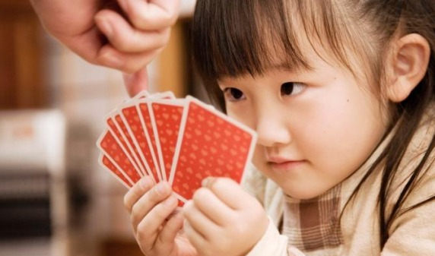
We have some ideas for you to make it fun!
Play games, play 21 with your child using cards, or race to 100 with dice or cards. Ask your child to teach these to you!
At the grocery store ask them how much two cans of tomatoes might cost and see if they can reason through that type of problem.
Find different places for real world discussion using numbers.
Play “war” with cards.
Use your school or teacher’s website to find good applications to use on the computer.

Slide 17
We thank you so much for taking the time to celebrate with your child!
We hope your family makes the most of your summer!
While this presentation is over with the teachers, we need to pick up our students from their specials. Please wait until you are released by administration for the awards ceremony in the classrooms.

